Slide 1

Executive Council
Saturday, August 1st, 2026
10:00 am - 3:00 pm
SKCDS.Org

Slide 2

Welcome!
Before we get started:
Bathroom codes in back
Refreshments
Lunch is at noon
Wi-Fi Password: msreguest
Orientation Packet:
Saturday, August 1st, 2026
10:00 AM - 3:00 PM | Fourth & Blanchard Building

Slide 3

INTRODUCTION
OUR VISION
Improving Oral Health for our Community
OUR MISSION
Helping Local Dentists Succeed
OUR HISTORY
Since its founding in 1892, the Society has promoted the highest levels of oral health for the citizens of King County and provided critical support and educational opportunities for the many dental professionals practicing in the County.

Slide 4
Agenda
10:00 am
12:00 pm
2:00 pm
3:00 pm
Welcome & Call to Order
Executive Council Goals for SKCDS Activity
Non-Profit Organizations - Dr. Megan Miller
Fiduciary & Governance Q&A - Esq. William Crowley
Lunch
Asana Presentation - SKCDS Staff
Beneficial State Bank - Jennifer Lovgren
SKCDS Orientation - Dr. April Dennison
Committees
Master Calendar
Financial Review
Expectations
Special Committees
SKCDS Office
Pending Motions
Review Mission & Vision
Upcoming Meetings & Adjourment

Slide 5

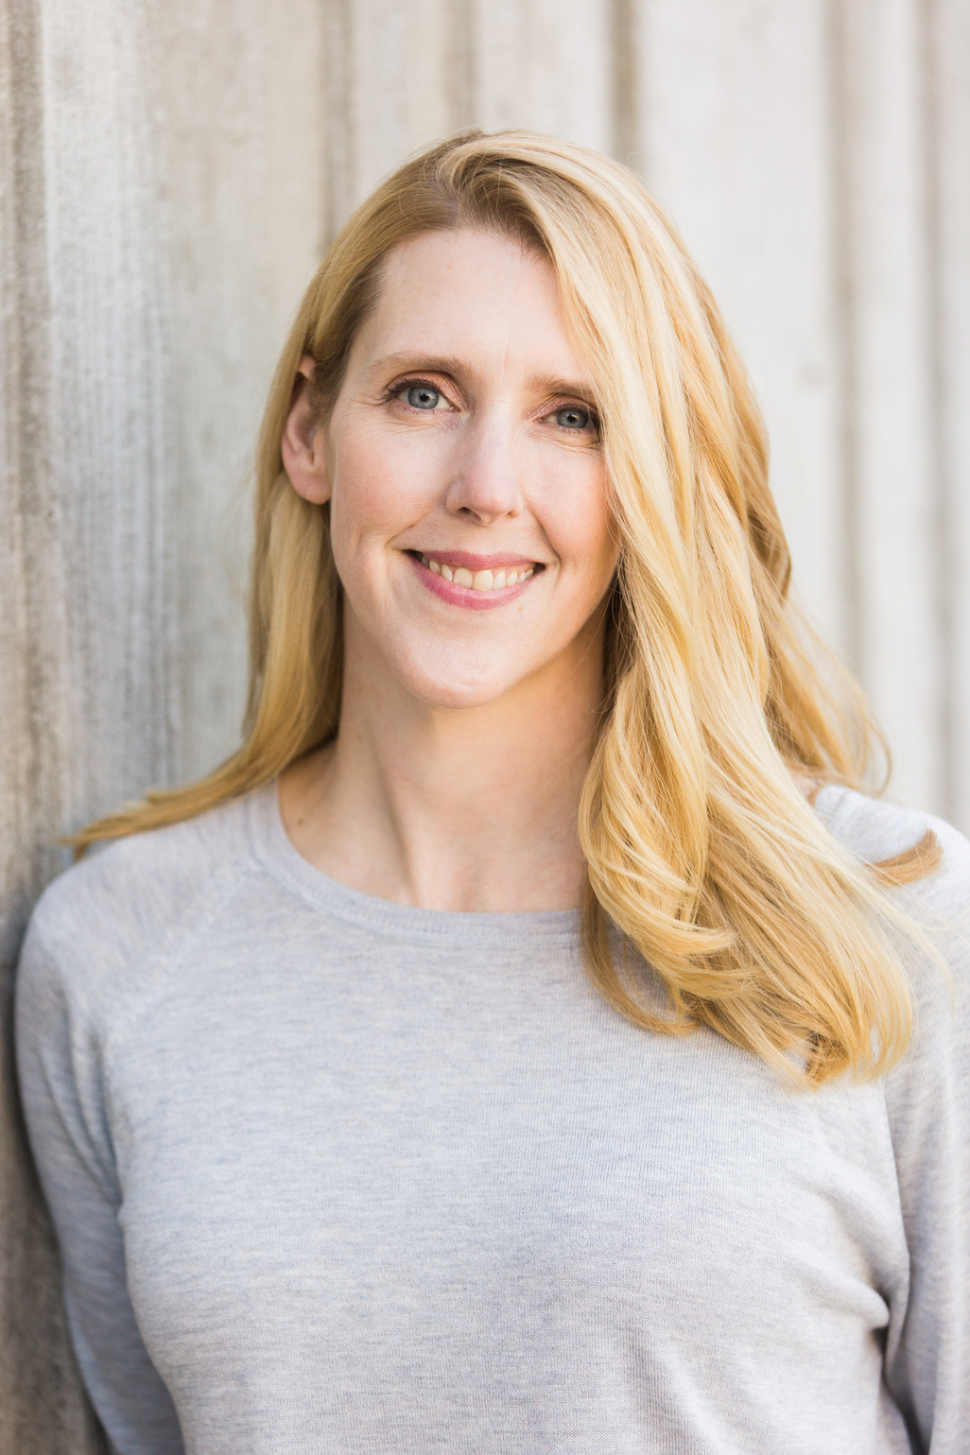
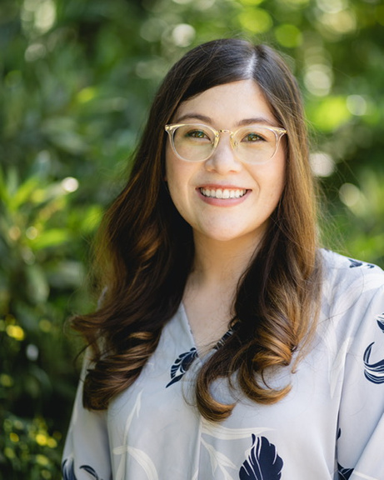
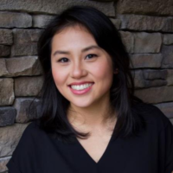
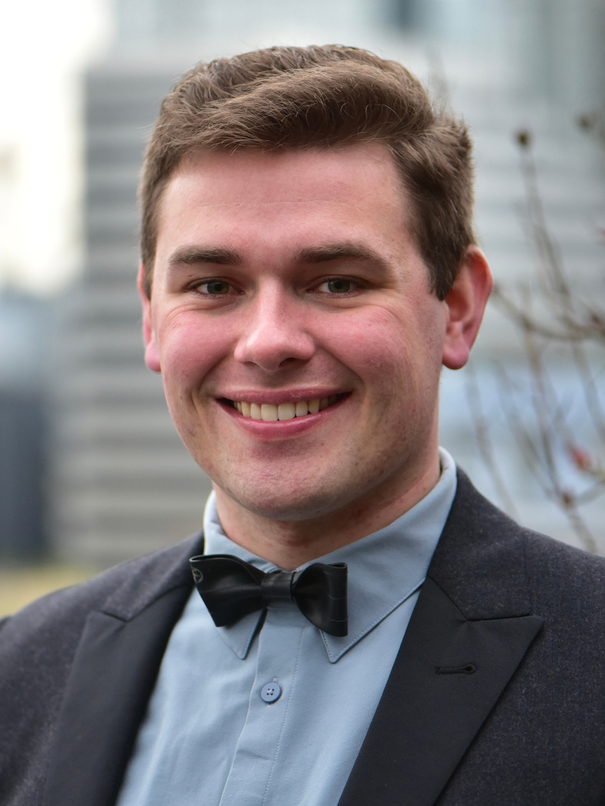
SKCDS - Your Team
Kate Christian
April Dennison
Kim Trieu
Philip Walczak
Past-President
President
Secretary
Treasurer

Slide 6
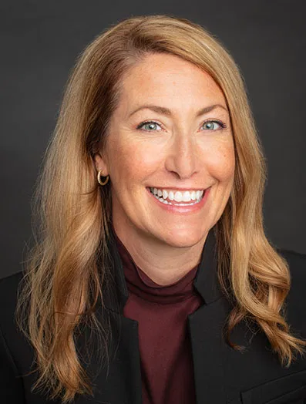
New Executive Council Members
Nikole O’Bryan
Kim Trieu
Philip Walczak
2026-27 New Member
2026-27 New Member & Secretary
2026-27 New Member & Treasurer

Slide 7

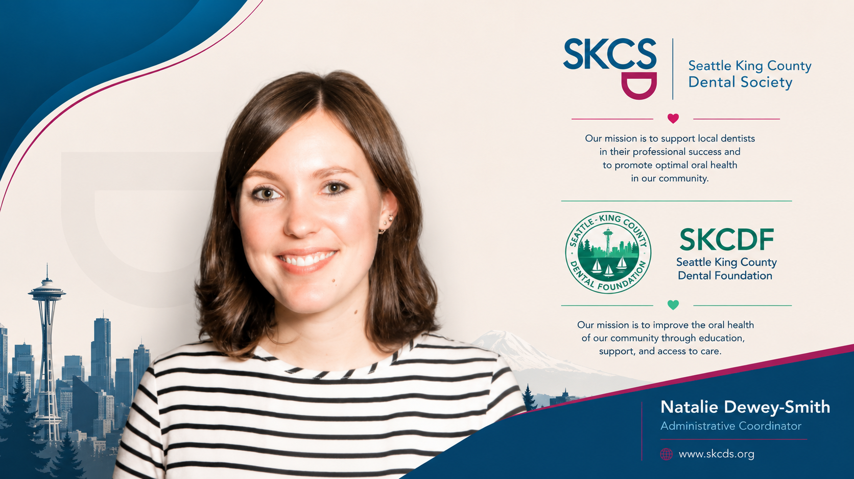
SKCDS Org - Staff
Tarah Hedman
Natalie Dewey-Smith

Slide 8


Thank you to our guests!
Jennifer Lovgren
William Crowley
Megan Miller

Slide 9


Slide 10
Non-Profit Organizations
Goal:
Equip Council members to govern confidently, ethically, and responsibly in support of SKCDS’s mission.

Slide 11



Leadership Work:
SKCDS Leadership starts with the mission.
Executive Council turns purpose into priorities, policies, resources and accountability.
SKCDS 501(C)6
SKCDF 501(C)3

Slide 12
Roles & Responsibilities
Executive Council
  Sets directon, policy, and organizational priorities
  Approve the annal budget and authroized expenditures
  Oversees risk, financial health and the Executive Director
  Reviews committee work and acts on recommendations
SKCDS Org Staff
  Manage operations within approved direction and resources
  prepare information, optiosn, budgets and deliverables
  Coordinates programs, communciations, vendors, and timelines
  Report progress, risks, and decisions requireing council action
The Council Governs; Staff Manages & Executes

Slide 13


Five officers anchor a 12-member Executive Council
President-Elect
President
Immediate
Past-President
Treasurer
Secretary
+ Seven Elected Members

Slide 14
ASANA

Slide 15
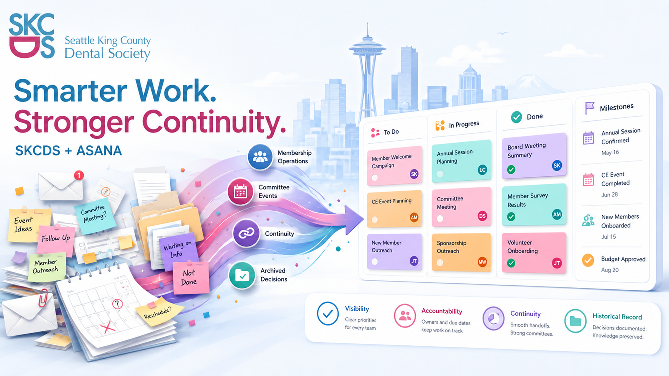
Saturday, August 1st, 2026
Tarah Hedman, M.B.A
  Why Asana
  Current State
  Asana Perks
  Log In
  Pilot
  Benefits
  What To Expect

Slide 16
Why Asana & Current State
Why:
  Improve visibility & accountability
  Keep projects moving forward between meetings
  Preserve Org History
  Support continutit
SKCDS:
  Turnover, hand-offs & drops
  Low visibility/awareness
  Frustration & Confusion
  MS, Google, personal, org

Slide 17
Asana will bring..
One organized location where committees, Staff and Volunteers can operate.

Slide 18
How to Log In
  Look for an invitation from Asana in your email.
  Select the link to join the SKCDS Asana workspace or project.
  Sign in using the email address that received the invitation.
  Create a password or use an available sign-in method.
  Confirm that you can see the SKCDS project.
Asana.com

Slide 19
What you will see
  Sections organized by meeting, event, or work category
  Individual tasks and action items
  Assigned task owners
  Due dates
  Current status
  Comments and discussion history
  Attachments and supporting materials
  Completed and deferred projects

Slide 20
SKCDS Pilot
  Migrated Master Calendar to Asana
  Membership Committee Pilot
  Staff Operations

Slide 21
Anticipated Benefits:
  Clearer ownership of action items
  Better preparation before meetings
  More effective use of meeting time
  Stronger coordination between staff and volunteer leaders
  Fewer missed or duplicated tasks (working on currently)
  Improved visibility into project status
  More consistent handoffs during leadership transitions
  Better documentation for future planning
  A sustainable record of institutional knowledge
One place for all communication

Slide 22
What to Expect:
During the pilot:
  The structure may be adjusted as we learn what works
  Some processes may initially feel unfamiliar
  Staff will provide guidance and respond to questions
  Committee feedback will be encouraged
  Expectations will be introduced gradually
  We will work through technical and workflow issues together

Slide 23
Q&A
Saturday, August 1st, 2026
Tarah Hedman, M.B.A

Slide 24

Financial Update
  Checks for HOD
Accounts Status
Checking: $110.401.00
Reserve: ~1.6m
Note: Programs in process
(Payments & Req. Deposits)

